Slide 1
NIIT Technologies
Digital 1000 – Polling System

Slide 2
Project Overview
The application allows you to create polls - and enables users (on particular IP) to vote on polls only once.
Software used:
Nodejs
Visual Code
MongoDB
MongoChef
The app uses the following libraries and frameworks:
HTML5/CSS/Javascript
AngularJS/Bootstrap 3 (Filters, Directives, API, Factory, Controller, SPA)
Node.js (Service, Express, Jade templates, Mongoose)
Socket.io

Slide 3
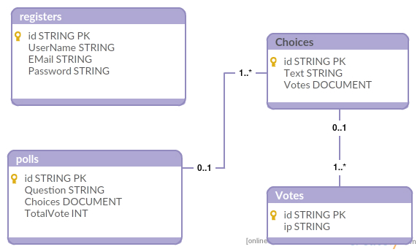
Database Design

Slide 4
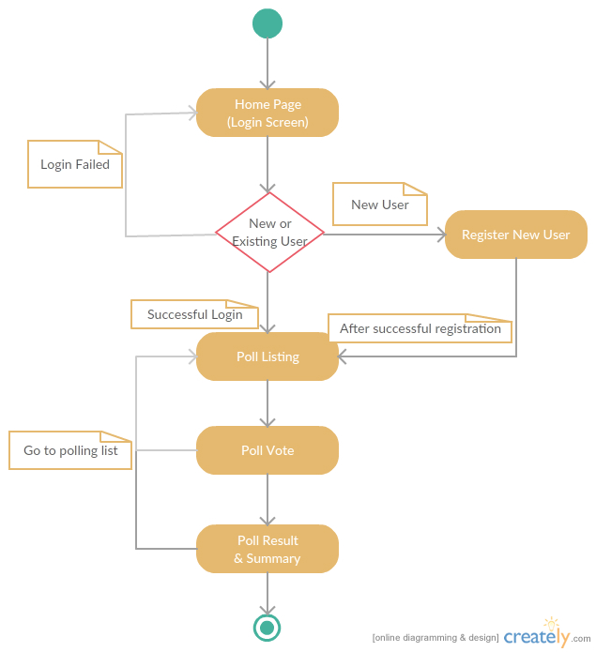
Activity Diagram

Slide 5
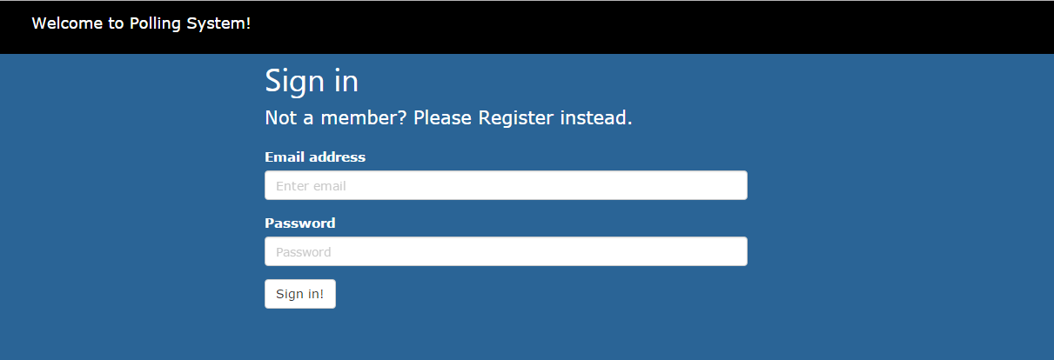
Home Screen – Login Page

Slide 6
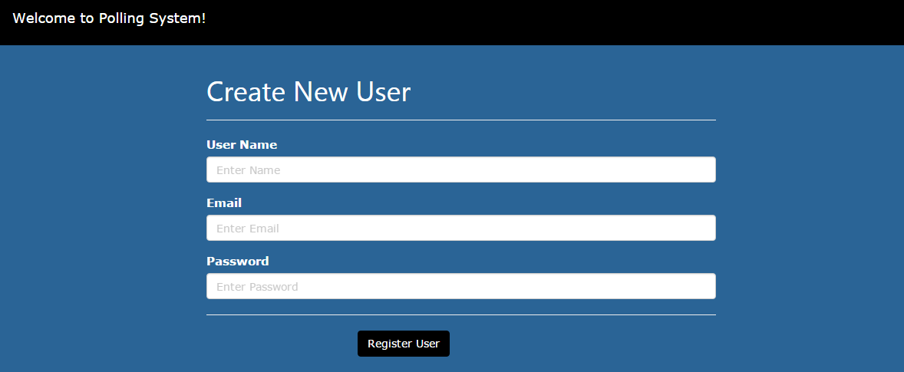
Register New User

Slide 7
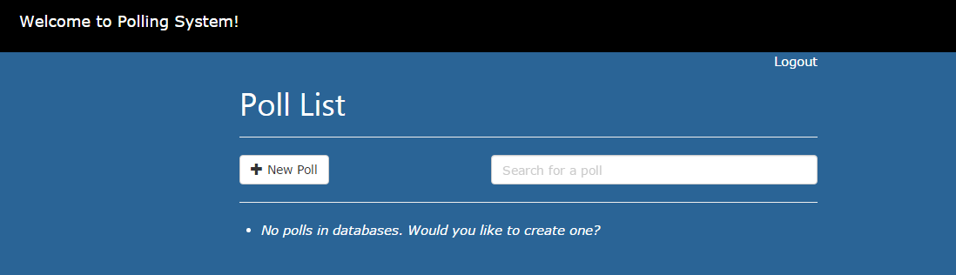
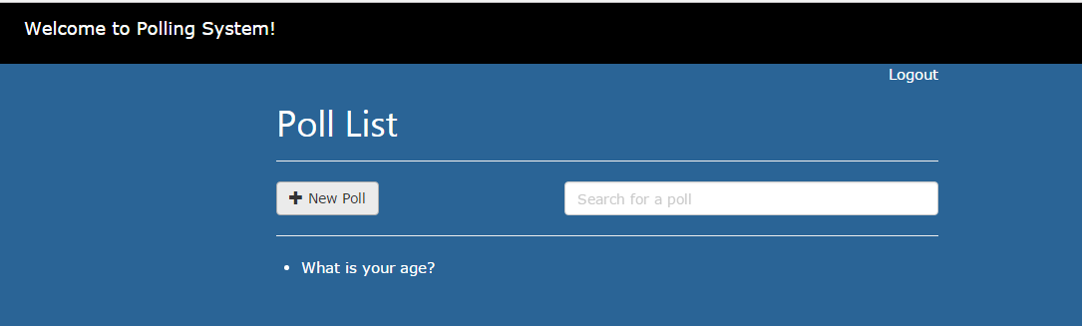
Polling List
Empty database, i.e. no polling question.
After adding new polling question.

Slide 8
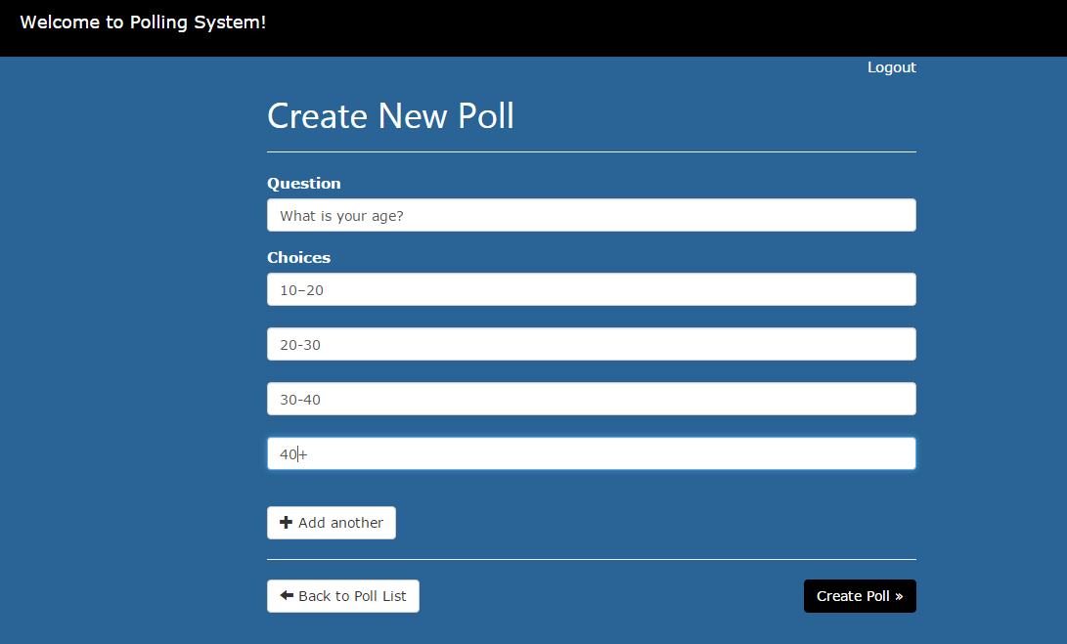
Create New Poll

Slide 9
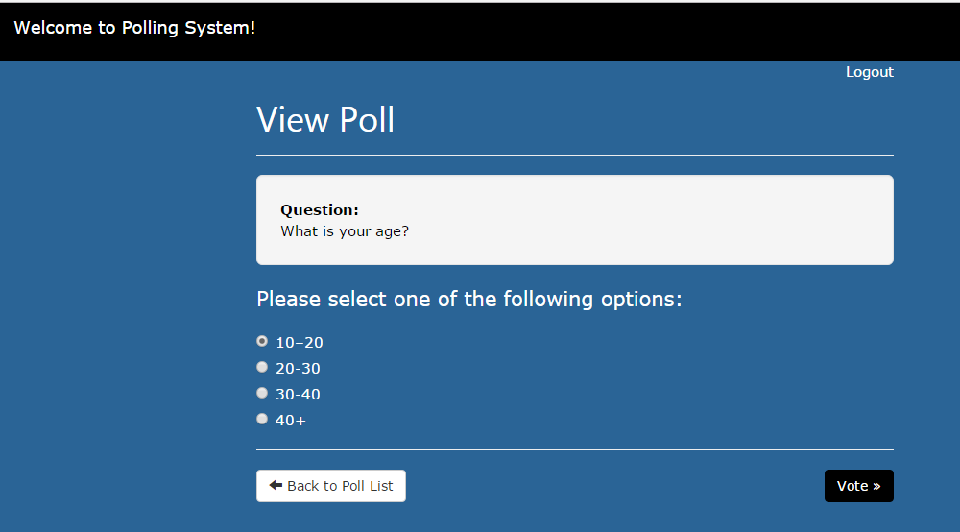
Poll Vote

Slide 10
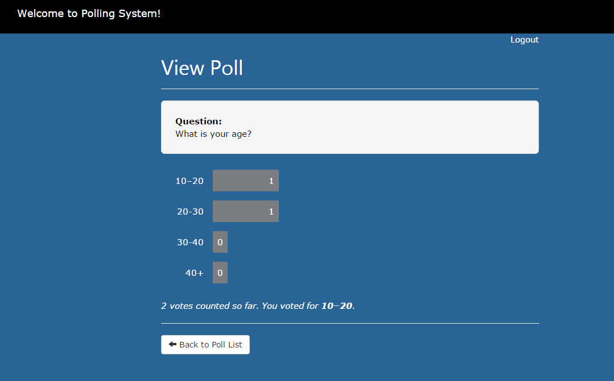
Result /Summary

Slide 11
Future Enhancements
User specific polling would be added, i.e. if one user has casted vote he/she can’t cast vote for same question again.
User roles would be added so that not all users can add polls.
Dashboard – to represent the graphically the popularity of question.

Slide 12
Project Team
Adya Bhatt
Akanksha Chatrath
Nidhi Rai
Nilabrata Gupta
Sweta Ghosh

Slide 13
Thank You
Thanks to Digital 1000 team

